Slide 1
What is GIS?
A geographic information system (GIS) is a computer-based tool for mapping and analyzing geographic phenomenon that exist, and events that occur, on Earth.
GIS technology integrates common database operations such as query and statistical analysis with the unique visualization and geographic analysis benefits offered by maps.
These abilities distinguish GIS from other information systems and make it valuable to a wide range of public and private enterprises for explaining events, predicting outcomes, and planning strategies.
Map making and geographic analysis are not new, but a GIS performs these tasks faster and with more sophistication than do traditional manual methods.

Slide 2
What is GIS?
Overall, GIS should be viewed as a technology, not simply as a computer system.
In general, a GIS provides facilities for data capture, data management, data manipulation and analysis, and the presentation of results in both graphic and report form, with a particular emphasis upon preserving and utilizing inherent characteristics of spatial data.
The ability to incorporate spatial data, manage it, analyze it, and answer spatial questions is the distinctive characteristic of geographic information systems.

Slide 3
GIS Subsystems.
A GIS has four main functional subsystems. These are:
a data input subsystem;
a data storage and retrieval subsystem;
a data manipulation and analysis subsystem; and
a data output and display subsystem.

Slide 4
GIS Subsystems.
A data input subsystem allows the user to capture, collect, and transform spatial and thematic data into digital form.
The data inputs are usually derived from a combination of hard copy maps, aerial photographs, remotely sensed images, reports, survey documents, etc.
The data storage and retrieval subsystem organizes the data, spatial and attribute, in a form which permits it to be quickly retrieved by the user for analysis, and permits rapid and accurate updates to be made to the database.
This component usually involves use of a database management system (DBMS) for maintaining attribute data.

Slide 5
GIS Subsystems
The data manipulation and analysis subsystem allows the user to define and execute spatial and attribute procedures to generate derived information.
This subsystem is commonly thought of as the heart of a GIS, and usually distinguishes it from other database information systems.
The data output subsystem allows the user to generate graphic displays, normally maps, and tabular reports representing derived information products.

Slide 6
GIS Subsystems
It is important to understand that the GIS is not a new invention. In fact, geographic information processing has a rich history in a variety of disciplines.
In particular, natural resource specialists and environmental scientists have been actively processing geographic data and promoting their techniques since the 1960's.
Today's generic, geographic information system, is distinguished from the geo-processing of the past by the use of computer automation to integrate geographic data processing tools in a friendly and comprehensive environment.

Slide 7
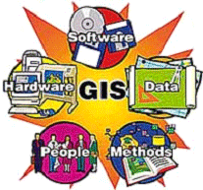
Components of A GIS

Slide 8
Components of A GIS
Hardware is the computer system on which a GIS operates. Today, GIS software runs on a wide range of hardware types, from centralized computer servers to desktop computers used in stand-alone or networked configurations.
GIS software provides the functions and tools needed to store, analyze, and display geographic information.
Data is Perhaps the most important component of a GIS. A GIS can integrate spatial data with other existing data resources, often stored in a corporate DBMS. This integration is a key functionality afforded by GIS.
People in GIS are those who manage the system and develop plans for applying it to real world problems. GIS users range from technical specialists who design and maintain the system to those who use it to help them perform their everyday work.
Methods help GIS to operate according to a well-designed implementation plan and business rules, which are the models and operating practices unique to each organization.

Slide 9
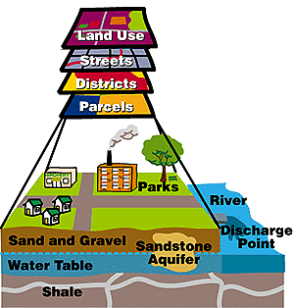
GIS Data Model
A GIS stores information about the world as a collection of thematic layers that can be linked together by geography.
This simple concept has proven valuable for solving many real-world problems from tracking delivery vehicles to modeling global atmospheric circulation.
The thematic layer approach allows us to organize the complexity of the real world into a simple representation to help facilitate our understanding of natural relationships.

Slide 10
GIS Data Types
GIS technology utilizes two basic types of data. These are:
Spatial Data: Which describes the absolute and relative location of geographic features.
Attribute Data: which describes characteristics of the spatial features. These characteristics can be quantitative and/or qualitative in nature. Attribute data is often referred to as tabular data.
The coordinate location of a forestry stand would be spatial data, while the characteristics of that forestry stand, e.g. cover group, dominant species, height, etc., would be attribute data.
Other data types, in particular image and multimedia data, are becoming more prevalent with changing technology.
Depending on the specific content of the data, image data may be considered either spatial, e.g. photographs, animation, movies, etc., or attribute, e.g. sound, descriptions, narration's, etc.

Slide 11
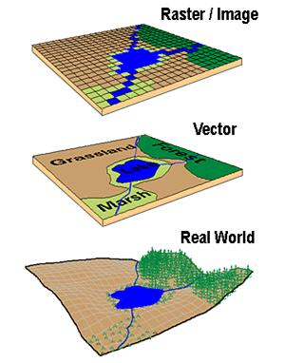
Special Data Models
Three basic types of spatial data models have evolved for storing geographic data digitally. These are referred to as:
Vector
Raster
Image

Slide 12
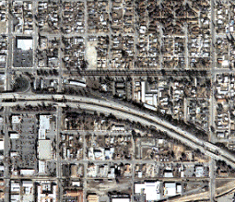
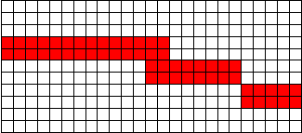
Spatial Data models
Vector formats
Discrete representations of reality
Raster formats
Use square cells to model reality
X,Y
X,Y
X,Y
X,Y
Reality (A highway)
Rows
X,Y
Columns
Notes:
You can represent geographic features in vector or raster format.
Vector data
The vector data model represents geographic features much the same way maps do—using points, lines, and areas. An x,y (Cartesian) coordinate system references real-world locations.
Raster data
Instead of representing features by their x,y coordinates, the raster data model assigns values to cells that cover coordinate locations. Raster format is well suited to spatial analysis and is also appropriate for storing data collected in grid format. The amount of detail you can show for a particular feature depends on the size of the cells in the grid. This makes raster data inappropriate for applications where discrete boundaries must be known, such as parcel management.

Slide 13
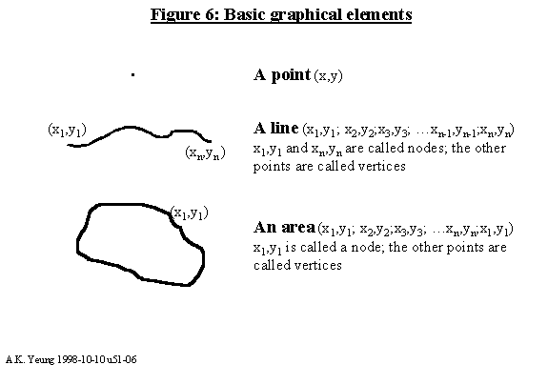
Vector Data Format

Slide 14
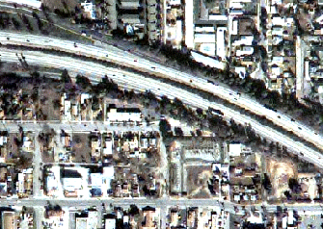
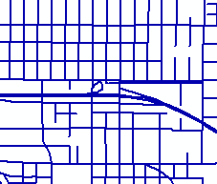
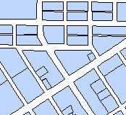
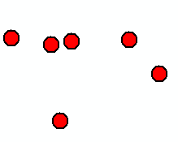
Representing features in vector data
Real-world entities are abstracted into three basic shapes
Retail stores
Streets
Land uses
Points
Lines
Areas/Polygons
Notes:
Abstracting real-world entities
It is impossible to capture everything from reality inside a computer. Instead, GIS users must somehow abstract real-world phenomena, or entities, into a geometric representation of those entities. There are three basic geometric shapes used for geographic features: points, lines, and areas. These shapes can be called geometric objects, geometric features, or feature types.
Note that there are different methods of making these entities digital, including scanning and digitizing.

Slide 15
Raster data Format
Areas broken into ‘pixels’ or cells Each cell contains data
Good at representing
dense data
land cover
Elevation
Notes:
Abstracting real-world entities
It is impossible to capture everything from reality inside a computer. Instead, GIS users must somehow abstract real-world phenomena, or entities, into a geometric representation of those entities. There are three basic geometric shapes used for geographic features: points, lines, and areas. These shapes can be called geometric objects, geometric features, or feature types.
Note that there are different methods of making these entities digital, including scanning and digitizing.

Slide 16
Vector versus Raster presentation

Slide 17
Image Data Type
Image data is most often used to represent graphic or pictorial data.
Most often, image data is used to store remotely sensed imagery, e.g. satellite scenes or orthophotos, or ancillary graphics such as photographs, scanned plan documents, etc.
Image data is typically used in GIS systems as background display data.
Typically, this data must be converted into a raster format (and perhaps vector) to be used analytically with the GIS.

Slide 18
Attribute data Model
A separate data model is used to store and maintain attribute data for GIS software.
These data models may exist internally within the GIS software, or may be reflected in external commercial Database Management Software (DBMS).
A variety of different data models exist for the storage and management of attribute data. The most common are:
Tabular
Hierarchial
Network
Relational
Object_oriented

Slide 19
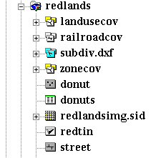
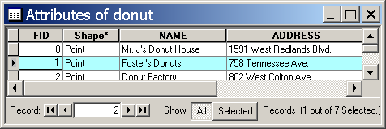
Connecting spatial with attribute data
Single feature class
Attributes stored in dBASE table
Donut shapefile
Donut.dbf table
Shape field accesses separate coordinate files
Notes:
Data format: Shapefile
Shapefiles can only contain one feature class. Therefore, a donut shop point feature class (representing the building’s point location) must be stored in a different shapefile as a donut shop polygon feature class (representing the building’s footprint).
Regardless of feature type, a shapefile’s default attribute table is stored in dBASE format and is named shapefile.dbf (e.g., donut.dbf). You can access this table in ArcGIS applications or dBASE. Additionally, shapefiles are the native format for ArcView 3.x, so you can view, display, and edit both the spatial and attribute data in ArcView 3.x.
Shapefiles are a vector file structure for storing the location and attribute information of points, lines, or areas. Each shapefile consists of at least three files: shapefile.shp, shapefile.shx, and shapefile.dbf (e.g., donut.shp, donut.shx, and donut.dbf).
If your shapefile has a defined coordinate system, the spatial reference information will be stored in the shapefile.prj file (e.g., donut.prj). Note that all GIS spatial data layers are stored in some type of coordinate system and the definition of the coordinate system should be maintained in the database dictionary, the shapefile.prj, the metadata file, or all three. In addition to the three basic files (SHP, SHX, DBF), other files may be created and/or used by ArcGIS software as needed.

